Slide 1
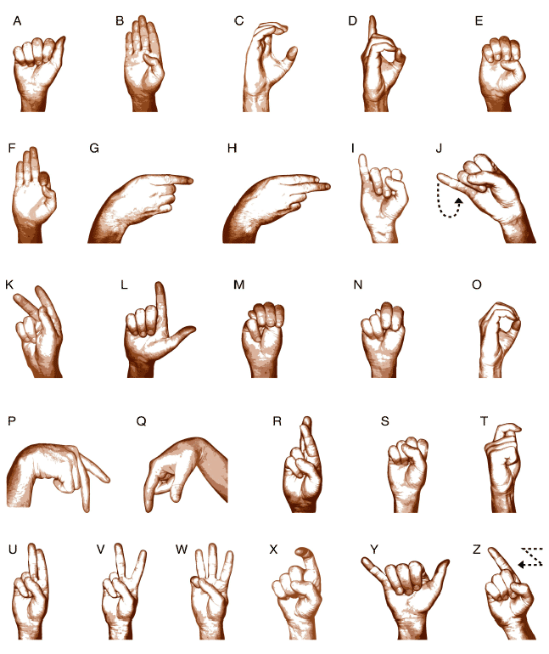
Towards a nuanced understanding of effective conduct of examinations: The case of SASL HL
20 - 23 May 2019
Dr SP Mchunu & Ms ML Madalane

Slide 2
PRESENTATION OUTLINE
Background
Purpose and question
Literature review
Study Methods
Research Findings
Emerging Issues
Recommendations
Conclusion

Slide 3
Background
Umalusi is required by legislation to assure the quality of learner assessment at exit points.
Quality assurance of assessment is done though:
Moderation of school based assessment
Moderation of question papers
Monitoring the conduct examinations
Verification of marking
Standardisation of marks

Slide 4
Background cont.
A number of subjects were written for the first time in 2018
Including South African Sign Language (SASL)
SASL is one of the visual-spatial native languages used by the Deaf community in South Africa
From 2010, DBE developed the SASL HL CAPS.
SASL HL was introduced in Foundation Phase and Senior Phase in 2015.
In 2016, SASL was introduced in Intermediate Phase and FET Phase.
Guidelines for the conduct of exam were developed in 2018

Slide 5
Background cont.
Exam takes place in SASL laboratory.
No pen and paper is used except for rough work.
Learners answer signed question papers in laptops with webcam.
Answers are recorded and saved in the laptops.
Learners’ responses are saved in memory sticks for marking.

Slide 6
Background cont.
In 2017, a preliminary study was conducted to provide guidance to Umalusi on the quality assurance of SASL HL.
Why? To understand:
how Deaf learners are assessed;
what kind of resources and material are required;
Including the kind of potential moderators and evaluators.
Recommendation in the preliminary study forms the bases of this paper

Slide 7
Purpose and Question
The purpose of this study is to investigate whether the preliminary study recommendations were implemented for the effectiveness of the conduct of the 2018 SASL HL examinations.
Question:To what extent were the preliminary research recommendations implemented for the effectiveness of the conduct of the 2018 SASL Home Language?

Slide 8
Literature
(Haug et al., 2016; Reagan, 2002 and Newell, 1995):
Include Deaf native signers with academic training;
Involve Deaf/Hearing experts with different areas of expertise.
Meet the needs of Deaf learners;
Experience in working with Deaf learners and in teams.

Slide 9
Study Methods
The study is located within the qualitative research paradigm.
Data collection was through document analysis.
The 2018 quality assurance of assessment (QAA) report
Guidelines on the conduct and implementation of SASL HL examinations.

Slide 11
Preliminary Study Recommendations | Application
Test developers to include: native signers (qualified Deaf academics and/or qualified, hearing SASL professionals). | A team of qualified Deaf and hearing academics set the SASL Home Language question papers.
The DBE to appoint technical experts to deal with the editing of question papers that are developed in PowerPoint. | Department of Basic Education appointed two technical experts, that is, one hearing technical expert and one Deaf technical expert.

Slide 12
Preliminary Study Recommendations | Application
A panel or team of external moderators is encouraged for SASL HL moderation. Each panel or team should comprise one Deaf SASL academic and two qualified SASL hearing professionals. | The external moderation team included qualified SASL Deaf and hearing professionals.
Assessments make use of only sign language with questions presented via laptops and answers recorded on laptops with webcams. No paper and pen should be used. | The SASL examination rooms were equipped with sufficient laptops with a webcam for each candidate. No pen and paper was used by candidates during the examinations.

Slide 13
Preliminary Study Recommendations | Application
Each school should have a technical person to deal with any technological challenges that may arise while the SASL examinations are in progress. | Each school offering SASL Home Language had a technician during examinations.
Marking should be done at a national level because the small number of SASL HL candidates. | Marking was indeed centralized and the assessment body was responsible for ensuring that all marking happens at a national level as recommended.

Slide 14
Preliminary Study Recommendations | Application
The SASL markers should be fluent signers and include Deaf persons. | Markers included Deaf persons; however, some markers did not possess the fluency. To mitigate this challenge, scripts were moderated by fluent signers.
The DBE to appoint SASL HL subject advisors to support teachers and to moderate the school based assessments (SBA). | This matter is being attended to. The DBE is in the process of appointing the subject advisors.

Slide 15
Preliminary Study Recommendations | Application
The DBE should ensure that resources, such as the SASL laboratories, are technologically flawless and ready for the Grade 12 SASL HL examination. | The SASL examination rooms were equipped with sufficient laptops with a webcam for each candidate. Computers complied with the hardware and software requirements.
Umalusi to give staff members basic training in SASL, especially those that will be dealing with question paper moderation, monitoring and evaluation. | Umalusi is using interpreters to communicate with Deaf moderators. The services are well provided and the need for Umalusi to train staff on SASL is no longer there.

Slide 17
Emerging Issues
The quality of SBA component and internal moderation is low for SASL HL.
Marking SASL HL on screen and on an English adapted/transcribed marking guideline is a challenge as some markers do not possess the fluency in the language to recognise similar responses.

Slide 18
Recommendations
The DBE should appoint SASL HL subject advisors or give any support to teachers to ensure learner preparedness for the examinations.
A signed version of the marking guideline should be available for both hearing and Deaf markers.

Slide 19
Conclusion
The expertise in SASL Hl still needs to be increased.
Teacher training needs: Literature – poetry.
The internal quality assurance (assessment body) of SBA still remains a challenge.
The visual-gestural nature of this language has a huge implication for assessment.
Cost (Financial) implications
Physical resources
Human resources

Slide 20
THANK YOU

